Slide 1
A Lesson in Prejudice and Stereotypes

Slide 2
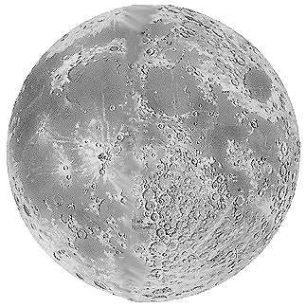
Choose your apprentice
You are an entrepreneur, like Alan Sugar on The Apprentice.
You need to ‘hire’ an engineer to set up life on the moon!
It’s a big, challenging job that will make history.
It needs the right apprentice - someone with resilience, determination, engineering expertise and great people skills!

Slide 3
Choose your apprentice
Line up the cards in front of you - that is your apprentice line up.
Each time I reveal a layer of information about each apprentice, you need to ‘fire’ one person by removing them from your line up.
Who will you ‘fire’ and ‘hire’?

Slide 4
Choose your apprentice
Ali | Patrick | Jamie | David | Adriana | Hannah | Delroy
The apprentices…
Fire one now so you have six remaining

Slide 5
Choose your apprentice
Fire one now so you have five remaining
Ali Abdul
Patrick Murphy
Jamie Small
David Campbell
Adriana Carboni
Hannah Mann
Delroy
Bailey

Slide 6
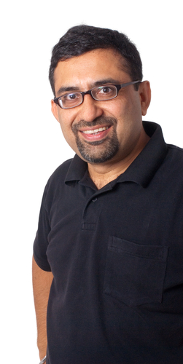
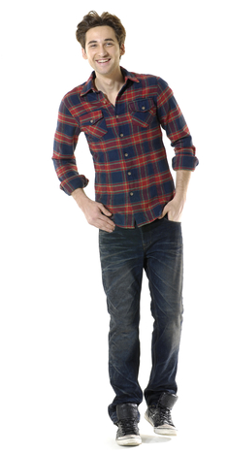

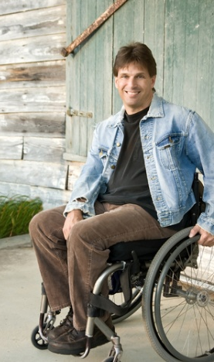
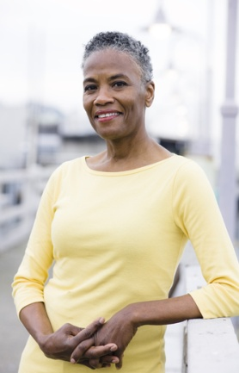

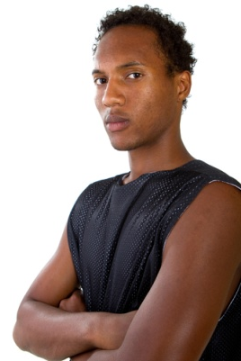
Choose your apprentice
Ali Abdul
Patrick Murphy
Jamie Small
David Campbell
Adriana Carboni
Hannah Mann
Delroy
Bailey
Fire one now so you have four remaining

Slide 7
Choose your apprentice
Fire one now so you have three remaining
Ali Abdul
Patrick Murphy
Jamie Small
David Campbell
Adriana Carboni
Hannah Mann
Delroy
Bailey
Hetero-sexual
Gay
Lesbian
Hetero-sexual
Hetero-sexual
Hetero-sexual
Hetero-sexual

Slide 8
Choose your apprentice
Ali Abdul
Patrick Murphy
Jamie Small
David Campbell
Adriana Carboni
Hannah Mann
Delroy
Bailey
Physically fit but wears glasses
Physically and mentally fit
Physically fit and mentally fit
Physically disabled, mentally fit
Physically and mentally fit
Pregnant, physically & mentally fit
Physically fit but suffers anxiety
Fire one now so you have two remaining

Slide 9
Choose your apprentice
Ali Abdul
Patrick Murphy
Jamie Small
David Campbell
Adriana Carboni
Hannah Mann
Delroy
Bailey
Ex-Army
Entrepren-eur / business man
Firewoman
Doctor of engineering
Engineer and project manager
Army engineering officer
Engineer graduate
Fire one now so you have one remaining

Slide 10
Who was your choice?
What choice did you make?
Are you pleased with your hired apprentice?
Would you have made a different decision if you had the qualifications information first?
What is wrong with judging people with such little information?
What do you think influenced your decisions?
Do you think people often judge people like this in our everyday life?
What could be the consequences of pre-judging people?

Slide 11
Stereotypes and prejudice
Stereotypes: thinking all people who belong to a certain group are the same and labelling them, for example all young people who wear hoodies are thugs.
Prejudice: judging someone without knowing them, on the basis of what they look like or what group they belong to, for example all black people are good dancers.
How would you define or explain stereotypes and prejudice?

Slide 12
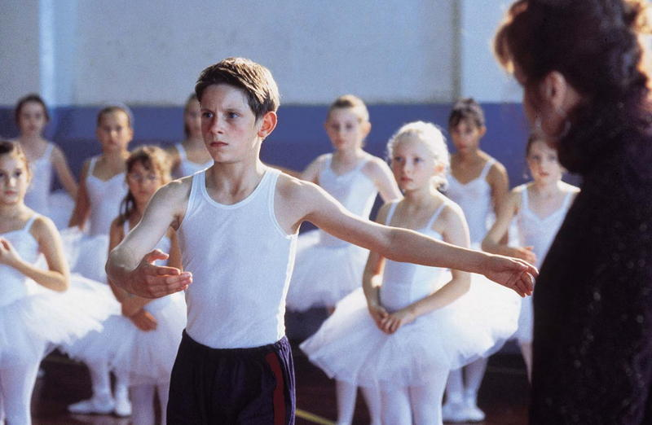
What is your reaction to this?
Notes:
http://www.google.co.uk/imgres?imgurl=http://cdn.mos.totalfilm.com/images/b/billy-elliot-800-75.jpg&imgrefurl=http://www.totalfilm.com/media/1910&usg=__DQKTpvxEd3l40defwoEUcZELKMU=&h=522&w=800&sz=53&hl=en&start=0&zoom=1&tbnid=H8Kk6phkiNmqlM:&tbnh=137&tbnw=199&ei=wI5iTYWJPMj44AaL0NXBCQ&prev=/images%3Fq%3Dbilly%2Belliot%26um%3D1%26hl%3Den%26sa%3DN%26rls%3Dcom.microsoft:en-gb:IE-SearchBox%26rlz%3D1I7ADBF_en-GB%26biw%3D1259%26bih%3D728%26tbs%3Disch:1&um=1&itbs=1&iact=rc&dur=140&oei=wI5iTYWJPMj44AaL0NXBCQ&page=1&ndsp=28&ved=1t:429,r:11,s:0&tx=112&ty=85
12

Slide 13
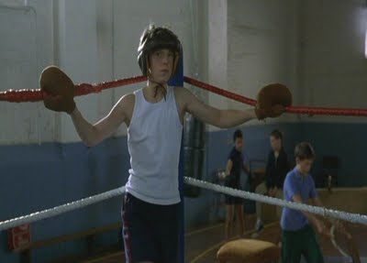
Does this seem better?
Notes:
http://www.google.co.uk/imgres?imgurl=http://4.bp.blogspot.com/_9WM7HW1RmWU/So8u9HSaN7I/AAAAAAAAAKs/R7irggrRCM8/s400/billy-DVD1.jpg&imgrefurl=http://allthingsfoe.blogspot.com/2009/08/jamie-bell-movie-propsbilly-elliot.html&usg=__MpDNwzklytfP0kAe0GPe7cLZ5ZI=&h=287&w=400&sz=12&hl=en&start=0&zoom=1&tbnid=gBwrdK3RXflaQM:&tbnh=129&tbnw=172&ei=NpBiTYXoKJP34AaH4uDLCQ&prev=/images%3Fq%3Dbilly%2Belliot%2Bboxing%26um%3D1%26hl%3Den%26rls%3Dcom.microsoft:en-gb:IE-SearchBox%26rlz%3D1I7ADBF_en-GB%26biw%3D1259%26bih%3D728%26tbs%3Disch:1&um=1&itbs=1&iact=hc&vpx=305&vpy=75&dur=3563&hovh=190&hovw=265&tx=152&ty=104&oei=NpBiTYXoKJP34AaH4uDLCQ&page=1&ndsp=25&ved=1t:429,r:1,s:0
13

Slide 14
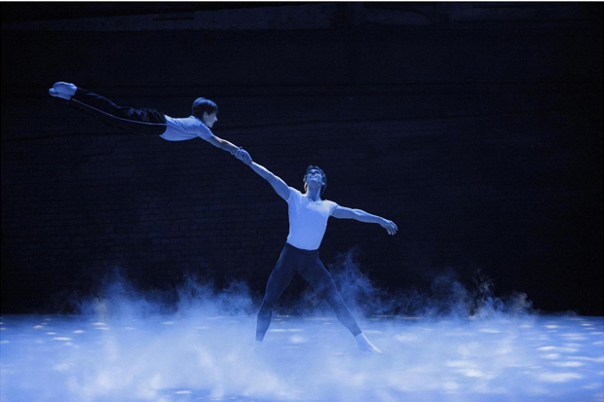
What is your reaction?
Billy Elliot was a boy who had a passion and gift for ballet, but he was forbidden to practice because it was for ‘girls’. He pursued his passion and became a successful ballerina, dancing in Swan Lake.

Slide 15
Gender stereotypes
Are there certain sports that are for girls and others for boys?
Is it fair that some things are labelled as girls or boys?

Slide 16
Gender stereotypes
Working in pairs, introduce yourself to your partner as a stereotypical girl or boy by completing these statements:
  My favourite color is…
  My favourite sport is…
  My favourite thing is…
  I wear…
  When I grow up I want to be…

Slide 17
Gender stereotypes
What statements did you make?
Was it easy to think of stereotypical labels?
How do you feel being labelled in this way?
What could be the problem with being labelled in this way?

Slide 18
Labelling teenagers
Consider:
How do you think adults, society and the media label teenagers?
Do different groups of young people get labelled in different ways?
What prejudiced attitudes or behaviour could this lead to?
.

Slide 19
Labelling teenagers
Do you think these labels / images are true or fair?
Could they lead to any problems?

Slide 20
Challenging stereotypes
Working in pairs, review the statements on the following slide which are all stereotypes.
Take it in turns to role-play:
  one person says the statement to their partner
  the other person acts in role of the stereotyped group and says:
    how the statement makes them feel
    why it isn’t true or fair to label all people like that.
Choose five statements each.
Students will be selected to present their conversation to peers.

Slide 21
Challenging stereotypes
Statements:
  All men are the same
  The woman’s place is in the home
  All black people are good at sports
  You have to talk slowly to a disabled person
  All kids are lazy
  Blonde women are stupid
  Elderly people are frail and boring
  Boys in hoodies are violent
  Asians are good at math
  White people are racist
  Boys that cry are gay

Slide 22
Riddle
Listen as I read out a riddle.
You will need to answer some questions that follow.

Slide 23
Riddle
A van driver whistles to a nurse on the street then swerves to miss a parked car and crashes into a young boy and his father who are driving to school. The father dies at the scene. The boy is transported to the hospital, taken immediately into surgery... but the surgeon steps out of the operating room and says, "I can't operate on this boy - he is my son”!

Slide 24
Riddle - questions
How can the boy be the surgeon’s son?
Is the van driver a man or woman?

Slide 25
Riddle - answers
How can the boy be the surgeon’s son?
  The surgeon could be a woman and it is her son.
Is the van driver a man or woman?
  Unknown – it could be man or woman. He or she could be whistling at a male or female nurse.

Slide 26
What have we learned?
That people have negative attitudes and what is meant by prejudice and stereotypes.
To be able to recognize my own and others stereotypical and prejudicial attitudes.
To be aware of the negative consequences of prejudice and stereotypes.

