Slide 1
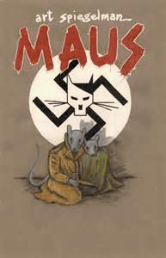
Maus
Art Spiegelman

Slide 2
Maus
Completed in 1991 by American cartoonist Art Spiegelman.
In 1992 it became the first graphic novel to win a Pulitzer Prize.
Frame story- beginning in 1978 in the Rego Park section of New York City
The story that Vladek tells is depicted in the narrative past, which begins in the mid-1930s and continues until the end of the Holocaust in 1945.

Slide 3
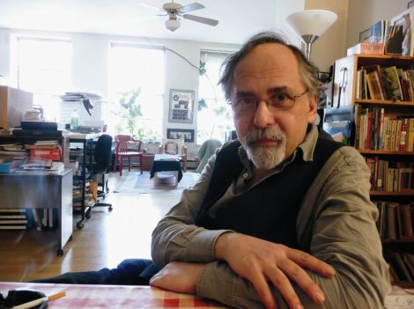
Author Info
Art Spiegelman was born on February 15, 1948 in Sweden, to Polish Jews and Holocaust survivors Vladek (father) and Anja Spiegelman (mother).
His brother Richieu had been poisoned by an aunt in order to avoid capture by the Nazis four years before Art's birth.
He and his parents immigrated to the United States in 1951.
While he was growing up, his mother occasionally talked about Auschwitz, but his father did not want him to know about it.

Slide 5
Summary
Maus is a graphic novel depicting the horrors of the Holocaust.
The author, Art Spiegelman, interviews his father, Vladek, about his experience during the Holocaust.
Vladek is elderly and has a troubled relationship with Mala, his second wife.
Vladek has an obsession with living frugally and to spend much time with him frustrates Art deeply.
Father and son have a bonding experience over the sharing of Vladek’s stories, which are at once gripping and tragically sorrowful.

Slide 6
Summary Continued
The stories detail Vladek’s life as he moves from wealth to poverty
falls in love with his first wife, Anja,
raises a son, Richieu,
survives Auschwitz

Slide 7
Symbolism
The author depicts Jews as mice (do not confuse with rats!)
In the novel, the mice have soft features, conveying a level of friendliness and approachability.
the Polish as pigs
the Nazis as cats
They appear vicious around the mice, often looking angry and bearing their teeth
This serves as a function of dehumanizing the events of the Holocaust.
The Jews and Germans were in the midst of a cat and mouse game - the Jews were being hunted by ruthless Germans, just as cats hunt innocent mice.
. This juxtaposition serves to make the point that the 'cats' were preying on a completely innocent and happy group of people, and is designed to invoke an emotional response from the reader.

Slide 8
Themes
Race
Warfare
Memory and the Past
Family
Guilt and Blame

Slide 9
Finding theme in a symbol
• Masks—Things aren’t as they seem.
• Swastika—Discrimination usually has
negative results.
• Shrinking Art—Success can be overwhelming.
• Portraying all people as the same animal— Stereotyping can be dangerous

Slide 10
Masking Effect
The masking effect is an act of amplification through simplification.
Making the physical characteristics of a character vague, the reader can more easily place themselves into the story.
In Maus, while the characters were mice, they could easily be identified as people.
Walked upright
drove cars
wore clothing
everything about them was human, except for their heads. This ambiguity allowed to reader to put themselves into the story, and feel the emotions the characters were facing.

