Slide 1
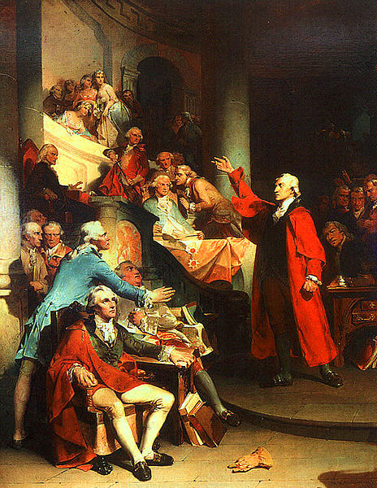
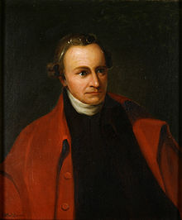
Patrick Henry’s “Speech to the Virginia Convention”
“Give me liberty or give me death!”
Rhetorical & Persuasive Strategies

Slide 2
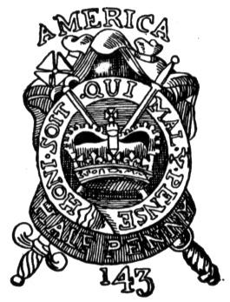
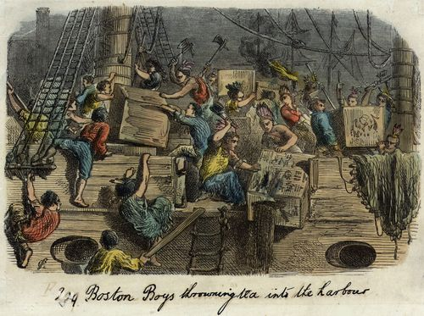
England’s Acts
First major opposition to British policy came in 1765 after Parliament passed the Stamp Act
Most colonists called for a boycott of British goods & some organized attacks on the customhouses and homes of tax collectors
Parliament voted to repeal the Stamp Act in March 1765
In 1773 came the Tea Act, which granted the East India Company a monopoly on the American tea trade

Slide 3
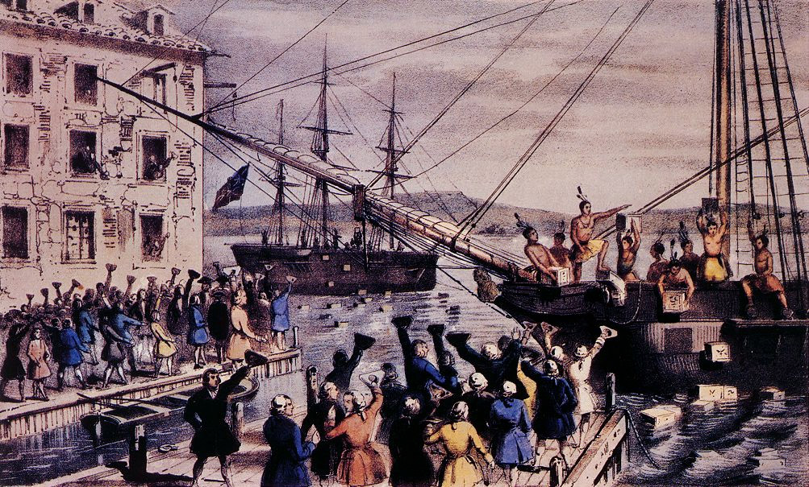
Viewed as another example of taxation without representation, militant Patriots in Massachusetts organized the “Boston Tea Party”
British tea, valued at 10,000 pounds, was dumped into the Boston harbor
Britain, outraged, enacted the Coercive Acts, or the
Intolerable Acts:
*closed Boston to merchant shipping
*established British rule in MA
*made British officials immune to criminal prosecution in America
*required colonists to quarter British troops

Slide 4
A Timeline of Events
March 24, 1765: Parliament passes the Quartering Act
March 25, 1774: Parliament passes the Boston Port Act
March 28, 1774: British Parliament adopts the Coercive Acts
March 23, 1775: Patrick Henry voices American opposition to British policy
http://youtu.be/XvJrSdr34co
a photographic and audio representation of Henry’s speech ☺

Slide 5
We Must Fight!
To avoid interference from Lieutenant-Governor Dunmore and his Royal Marines, the Second Virginia Convention met on March 20, 1775 in Richmond, instead of the Capitol in Williamsburg.
Delegate Patrick Henry introduced a resolution to the Virginia Convention to form the local militia to be prepared to fight the British.
Henry’s opponents urged caution and patience until the crown replied to Congress’ latest petition for reconciliation.
The resolution passed by five votes.

Slide 6
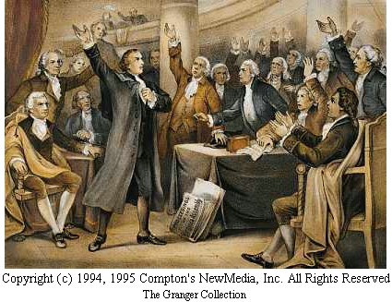
SOAPSTone
When reading Henry’s speech, one must consider the following key pieces:
Speaker: Patrick Henry
Occasion: the meeting of the VA Convention, before we declared independence
Audience: delegates of the VA Convention
Purpose: to encourage them to take up arms to fight the British
Subject: Fight!
Tone: urgent, pleading & inflammatory
The important consideration is who he is addressing.

Slide 7
Persuasion: a form of discourse (speaking) that uses Reason (Logos) and Emotional Appeals (Pathos) to convince another person to act/think in a certain way
Rhetorical Devices: are structures within language that appeal to readers or listeners and communicate ideas
Types of Devices:
•A rhetorical question is a question to which no answer is expected
•Antithesis or “Either/Or Fallacy” expresses contrasting ideas in parallel grammatical structures
•Repetition is the recurrence of words, phrases, or lines.
•Parallelism is a kind of repetition in which words or phrases in the same grammatical form connect ideas.
•Biblical allusions are references to events, figures, or phrases from the Bible. In this selection, they have the rhetorical appeal of shared beliefs.

Slide 8
St. John's Church, Richmond, Virginia
March 23, 1775.
MR. PRESIDENT: No man thinks more highly than I do of the patriotism, as well as abilities, of the very worthy gentlemen who have just addressed the House. But different men often see the same subject in different lights; and, therefore, I hope it will not be thought disrespectful to those gentlemen if, entertaining as I do, opinions of a character very opposite to theirs, I shall speak forth my sentiments freely, and without reserve.
Why begin his speech this way?
*This could be regarded as a concession to the opposing view that patriotism is important.
*It could also be a refutation to the opposing side who may say that only those who are not patriots would fight the British.
*He is showing respect for those who hold the opposing view to his.
*Persuasive: flattery
Light: represents truth and spiritual illumination, aligning his view of the need to fight with God’s purpose

Slide 9
This is no time for ceremony. The question before the House is one of awful moment to this country. For my own part, I consider it as nothing less than a question of freedom or slavery; and in proportion to the magnitude of the subject ought to be the freedom of the debate. It is only in this way that we can hope to arrive at truth, and fulfill the great responsibility which we hold to God and our country. Should I keep back my opinions at such a time, through fear of giving offence, I should consider myself as guilty of treason towards my country, and of an act of disloyalty toward the majesty of heaven, which I revere above all earthly kings.
*Henry is referring to the need to fight for freedom.
*This is known as an either/or fallacy to create PATHOS.
*He is trying to convince them that there is only one alternative to fighting=slavery.
*He creates an appeal to authority, or ETHOS, calling on God’s truth (fighting for freedom). He aligns God on the side of the colonists fighting for their freedom.
*By juxtaposing God as “majesty of Heaven,” and “king” for King George, his creates an appeal to authority, or ETHOS, placing God above the king.
*God has a greatness of character; the king only has a position of authority.

Slide 10
Mr. President, it is natural to man to indulge in the illusions of hope. We are apt to shut our eyes against a painful truth, and listen to the song of that siren till she transforms us into beasts. Is this the part of wise men, engaged in a great and arduous struggle for liberty? Are we disposed to be of the number of those who, having eyes, see not, and, having ears, hear not, the things which so nearly concern their temporal salvation? For my part, whatever anguish of spirit it may cost, I am willing to know the whole truth; to know the worst, and to provide for it.
What part of the argument is it when he addresses the President again?
*a concession to the opposition & a refutation (argument against their side)
*He refutes by saying that freedom without fighting is only an illusion---it cannot be a reality.
*Important lines of
a) Mythical allusion
b) Parallelism (which is also a Biblical allusion to Ezekiel 12:2)
*Henry is metaphorically comparing how the British are saying things to colonists, which are false hopes to how Circe (in Homer’s Odyssey) transformed men into swine after charming them with her singing.
*This is both an appeal to authority (ETHOS) and an appeal to PATHOS.

Slide 11
I have but one lamp by which my feet are guided; and that is the lamp of experience. I know of no way of judging of the future but by the past. And judging by the past, I wish to know what there has been in the conduct of the British ministry for the last ten years, to justify those hopes with which gentlemen have been pleased to solace themselves, and the House? Is it that insidious smile with which our petition has been lately received? Trust it not, sir; it will prove a snare to your feet. Suffer not yourselves to be betrayed with a kiss. Ask yourselves how this gracious reception of our petition comports with these war-like preparations which cover our waters and darken our land. Are fleets and armies necessary to a work of love and reconciliation? Have we shown ourselves so unwilling to be reconciled, that force must be called in to win back our love? Let us not deceive ourselves, sir. These are the implements of war and subjugation; the last arguments to which kings resort.
*Henry uses a metaphor of the lamp, which is also a Biblical allusion saying that God’s word (which is truth) is a “lamp unto thy feet and a light unto thy path.”
*This is an appeal to authority (God/Bible) and an appeal to ETHOS, because it shows him as a spiritual person.
*An appeal to LOGOS (logic) when Henry says he can judge the future by using his knowledge of the past
*”insidious smile” appeals to PATHOS (British fooling colonists)
*Biblical allusion and metaphor---Judas betraying Jesus
*Henry also employs the rhetorical question to make the colonists recognize that British are prepping for war
*Henry also appeals to PATHOS by using words like “implements of war and subjugation”

Slide 12
I ask, gentlemen, sir, what means this martial array, if its purpose be not to force us to submission? Can gentlemen assign any other possible motive for it? Has Great Britain any enemy, in this quarter of the world, to call for all this accumulation of navies and armies? No, sir, she has none. They are meant for us; they can be meant for no other. They are sent over to bind and rivet upon us those chains which the British ministry have been so long forging. And what have we to oppose to them? Shall we try argument? Sir, we have been trying that for the last ten years. Have we anything new to offer upon the subject? Nothing. We have held the subject up in every light of which it is capable; but it has been all in vain. Shall we resort to entreaty and humble supplication? What terms shall we find which have not been already exhausted?
*Henry continues rhetorical questions that are followed by a declarative sentence answering the questions.
*Henry uses parallel independent clauses with “they are meant for us; they can be meant for no other.
*Henry also uses a metaphor with those who “bind and rivet…those chains,” creating an appeal to PATHOS (with slavery).
*Henry asks the audience:
What can we use to go against them? (argument?)
Is there anything we have not yet said? (nope)
Shall we kiss up to the King? (nope)
What promises should we try that have not already been used?

Slide 13
Let us not, I beseech you, sir, deceive ourselves. Sir, we have done everything that could be done, to avert the storm which is now coming on. We have petitioned; we have remonstrated; we have supplicated; we have prostrated ourselves before the throne, and have implored its interposition to arrest the tyrannical hands of the ministry and Parliament. Our petitions have been slighted; our remonstrances have produced additional violence and insult; our supplications have been disregarded; and we have been spurned, with contempt, from the foot of the throne. In vain, after these things, may we indulge the fond hope of peace and reconciliation. There is no longer any room for hope.
*Henry employs the parallel structure of “We have...we have” and “our…our” which indicates that all actions are equally important, but they become more emphatic in word choice.
*These are meant to create an appeal to PATHOS.
*The word choice is inflammatory, with words like “additional violence and insult” and “spurned.”
*These also create a rhetorical structure of cause and effect.

Slide 14
If we wish to be free, if we mean to preserve inviolate those inestimable privileges for which we have been so long contending, if we mean not basely to abandon the noble struggle in which we have been so long engaged, and which we have pledged ourselves never to abandon until the glorious object of our contest shall be obtained, we must fight! I repeat it, sir, we must fight! An appeal to arms and to the God of Hosts is all that is left us!
*This is Henry’s Call to Action—in a long periodic exclamatory sentence, which state the results of fighting.
*He creates a sense of urgency by using the exclamation point at the end of the repetition of “we must fight!”
*This is also an appeal to PATHOS.
*He is showing the desirable outcomes before he shows the undesirable way of attaining these goals, by fighting, which so many of them wanted to avoid.

Slide 15
They tell us, sir, that we are weak; unable to cope with so formidable an adversary. But when shall we be stronger? Will it be the next week, or the next year? Will it be when we are totally disarmed, and when a British guard shall be stationed in every house? Shall we gather strength by irresolution and inaction? Shall we acquire the means of effectual resistance, by lying supinely on our backs, and hugging the delusive phantom of hope, until our enemies shall have bound us hand and foot? Sir, we are not weak if we make a proper use of those means which the God of nature hath placed in our power. Three millions of people, armed in the holy cause of liberty, and in such a country as that which we possess, are invincible by any force which our enemy can send against us. Besides, sir, we shall not fight our battles alone.
*Henry begins with the opposing argument that the colonists are weak.
*This area is also incorporating rhetorical questions and a statement that refutes them.
*He creates an appeal to PATHOS through his description of the outcome of waiting. Henry also uses a metaphorical comparison here.
*The image of slavery is extended, creating PATHOS again.
*He refutes the statement, appealing to authority or ETHOS, giving credit to their power coming only from God.

Slide 16
There is a just God who presides over the destinies of nations; and who will raise up friends to fight our battles for us. The battle, sir, is not to the strong alone; it is to the vigilant, the active, the brave. Besides, sir, we have no election. If we were base enough to desire it, it is now too late to retire from the contest. There is no retreat but in submission and slavery! Our chains are forged! Their clanking may be heard on the plains of Boston! The war is inevitable, and let it come! I repeat it, sir, let it come.
*Henry is again uniting freedom with God’s will and saying that God is raising up allies.
*His last point of refutation is that there is no choice, because retreat would only result in slavery.
*This is yet another appeal to PATHOS, as listeners can picture themselves in chains, controlled by Britain.
*He uses sound imagery by saying, “Their clanking may be heard..”
*Here he creates an urgent call to arms in his imperative, exclamatory sentence of repetition.

Slide 17
It is in vain, sir, to extenuate the matter. Gentlemen may cry, Peace, Peace, but there is no peace. The war is actually begun! The next gale that sweeps from the north will bring to our ears the clash of resounding arms! Our brethren are already in the field! Why stand we here idle? What is it that gentlemen wish? What would they have? Is life so dear, or peace so sweet, as to be purchased at the price of chains and slavery? Forbid it, Almighty God! I know not what course others may take; but as for me, give me liberty or give me death!
*The last opposing argument is when he says, “Peace, Peace..” creating an appeal to PATHOS.
*He metaphorically describes the advancement of the British military as a “gale” which will “sweep the North.”
*Through the comparison, he is saying that just as a storm cannot be stopped by man, the British will not be stopped by man’s human strength.
*This refers back to his point that only through God’s power can the colonists win.
*Henry also creates an appeal to PATHOS with the concept of slavery in the rhetorical question.
*Henry uses antithesis (either/or fallacy) to show that liberty is equally as valuable and desirable as death (metaphorically under British rule) is destructive and undesirable.

Slide 18
Henry’s Speech
http://www.history.org/almanack/life/politics/giveme.cfm (listen to the audio file of the speech)
http://youtu.be/WsuWR5niBzA Interesting project on the first lines of the speech ☺

Slide 19
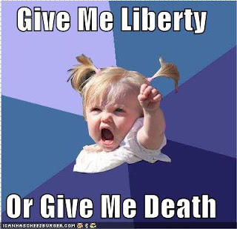
Bibliography
Notes on the Boston Tea Party and Patrick Henry
http://www.history.com/this-day-in-history/patrick-henry-voices-american-opposition-to-british-policy
http://www.history.org/almanack/people/bios/biohen.cfm
Photographs
www.socialstudiesforkids.com
Digital Text Version
Wirt, William. Sketches of the Life and Character of Patrick Henry. Philadelphia: 1836, as reproduced in The World’s Great Speeches. Lewis Copeland and Lawrence Van Lamm, 1973.

