Slide 1
American Romantic Period
Also known as the American Renaissance

Slide 2
The Romantic Period
The "Romantic Period" refers to literary and cultural movements in England, Europe, and America roughly from 1770 to 1860. Romantic writers (and artists) saw themselves as revolting against the "Age of Reason" (1700-1770) and its values. They celebrated imagination/intuition versus reason/calculation, spontaneity versus control, subjectivity and metaphysical musing versus objective fact, revolutionary energy versus tradition, individualism versus social conformity, democracy versus monarchy, and so on.

Slide 3
Romantic vs. Non-Romantic
ROMANTIC NON-ROMANTIC/Reason/Classic
Emotional Reasonable and Practical
Individualistic Public Responsibility
Revolutionary Conservative
Loves Solitude & Nature Loves Public, Urban Life Fantasy/Introspection External Reality
The Particular The Universal
Subjective Perception Objective Science
Satisfaction of Desire Desire Repressed
Organic Mechanical Form
Creative Energy/Power Mundane
Exotic Bourgeois Family
"Noble Savage"/Outcasts Materialist/Empirical Philosophy
Idealist Philosophy

Slide 4
Romanticism:
Reaction against rationalism
Value feeling and intuition over reason
“A journey away from the corruption of civilization and the limits of rational thought and toward the integrity of nature and the freedom of the imagination”
Art = intuitive, “felt” experience
Poetry = highest and most sublime embodiment of the imagination
Attacked science

Slide 5
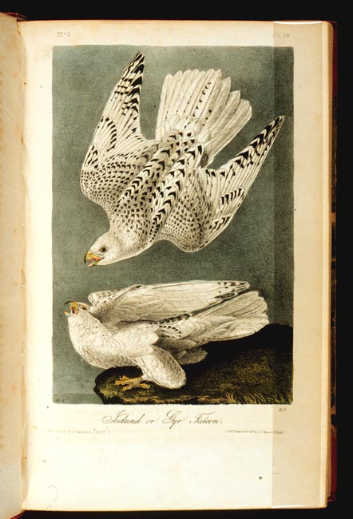
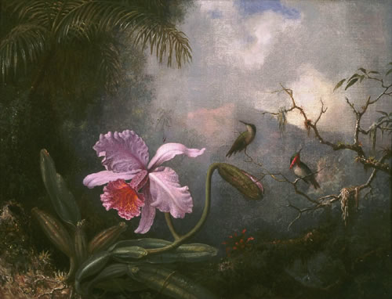
Classical (eighteenth century; “Enlightenment,” scientific revolution, “Age of Reason”)
stylistic tendencies: hard edges, clear colors, focused light
subject tendencies: historical figures, social and historical settings, human figures in foreground
Audubon, Gyrfalcon
Romantic painting
stylistic tendencies: softer edges and colors, diffuse light
subject tendencies: nature, human figures in background, human figures diminished, human figures not historical but fictional or “types”
Heade, Hummingbirds & Orchids

Slide 6
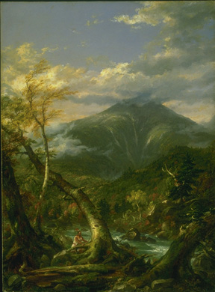
Indian Pass by Thomas Cole

Slide 7
Characteristics of American Romanticism
Values feeling & intuition over reason
Places faith in inner experiences & the power of the imagination
Prefers youthful innocence to educated sophistication
Individual freedom & the worth of the individual
Contemplates nature’s beauty as a path to spiritual and moral development

Slide 8
1800 - 1860
What’s going on in the world:
1803 – Louisiana Purchase
1810 – Mexico begins it’s war of independence from Spain
1812 – British attempt to take back America in the War of 1812
1815 – Napoleon defeated at Waterloo
1820-1821 – Missouri Compromise (free state/ slave state)
1830 – Underground railroad begins
1837 – Queen Victoria rules England
1845 – United States annexes Texas (leads to war with Mexico in 1846)
1849 – California gold rush
1854 – Republican party formed (opposed extension of slavery)
1858 – England takes over rule of India

Slide 9
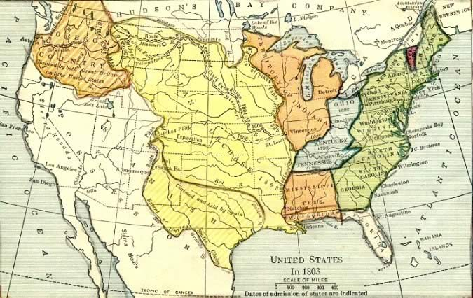
Louisiana Purchase
From France
4 cents an acre (15 million dollars total)
Doubled US Territory

Slide 10
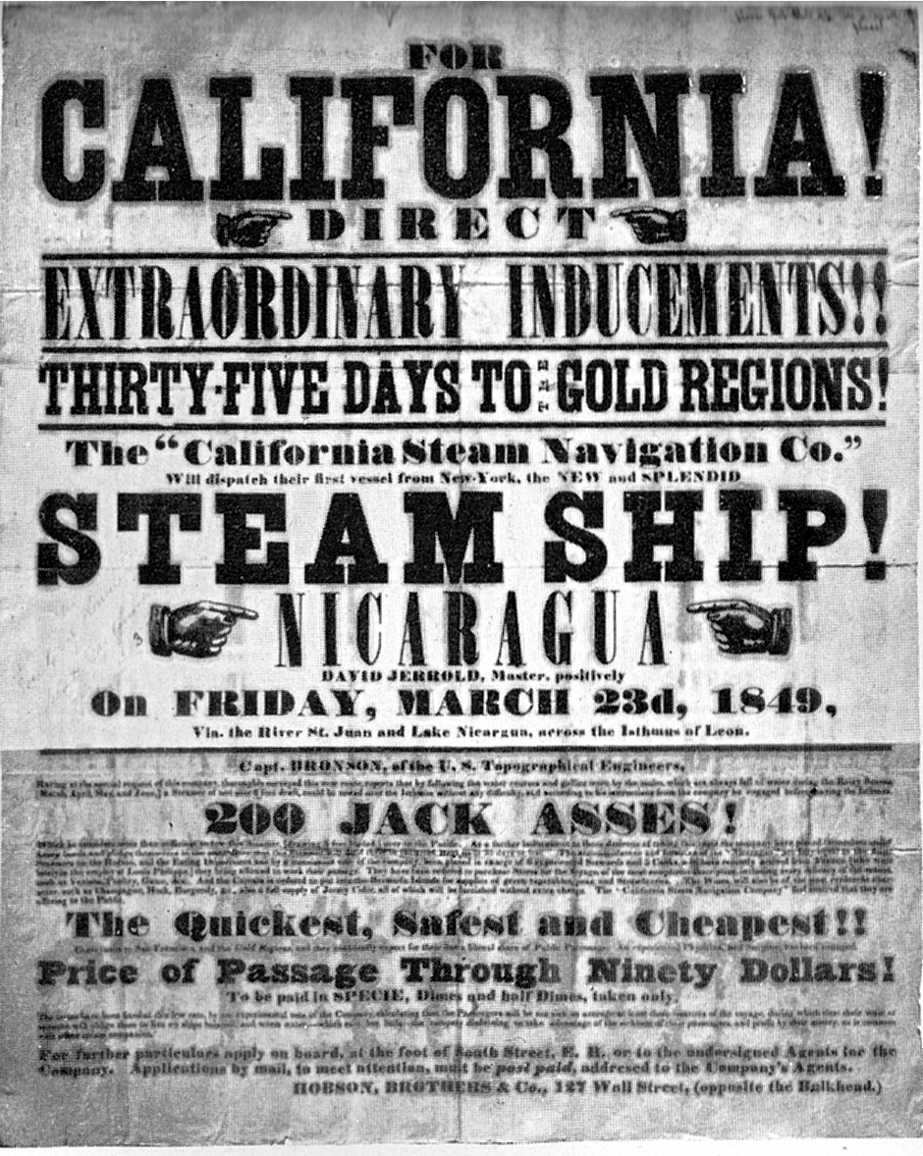
The Gold Rush 1848- 1855
Helped to develop the West
Led to the building of railroads
California and Alaska were major rushes

Slide 11
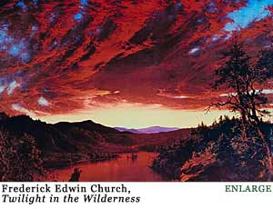
Romanticism
NOT about love
Values feeling and intuition over reason
Romantics believed that imagination could discover truths that the rational mind could not
Nature is very important
Those who dream by day are cognizant of many things which escape those who dream only by night.
-Edgar Allan Poe

Slide 12
Characteristics of the American Romantic period
Values feeling and intuition over reason
Values the imagination over reality
Civilization is bad Nature is good
Educated sophistication is bad Youthful innocence is good
Individual freedom is important
Nature is the way to find God
Progress is bad
Most settings are in exotic locales or the supernatural
Poetry is the highest expression of the imagination
Lots of inspiration from myths and legends

Slide 13
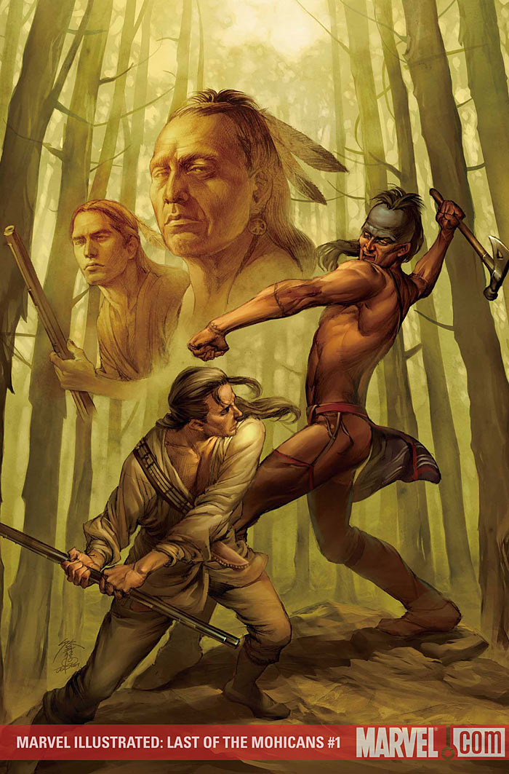
The American Hero
Young (or at least acts young)
Innocent and pure
Sense of honor higher than society’s honor
Has knowledge of people and life based on a deep understanding, not based on education
Loves nature
Quests for a higher truth

Slide 14
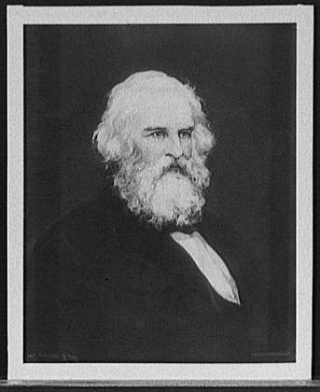
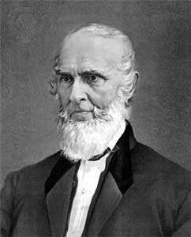
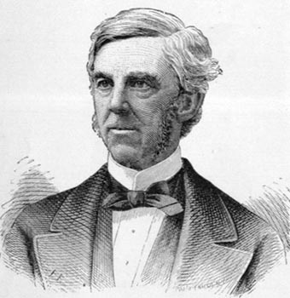
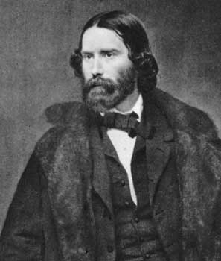
The Fireside Poets
Henry Wadsworth Longfellow
John Greenleaf Whittier
Oliver Wendell Holmes
James Russell Lowell

Slide 15
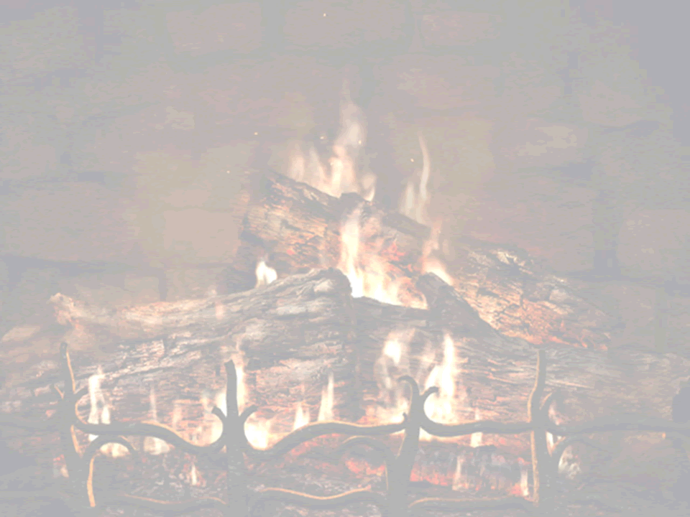
Fireside Poets
American poets who first rivaled British poets in popularity were fireside poets. These romantic poets were sentimental in their writing. In schoolrooms, children memorized and recited the poems. The rhyming meters made the poems easy to learn.
In the evening, around the hearth, parents read the poems to their children. These were the poets that captured the romantic spirit of America. The fireside poets were family entertainment to a young nation. Children and adults had no television or radio to entertain them.

Slide 16
Fireside Poets: Longfellow
The fireside poets used the fire in the fireplace as a metaphor. Listening to the words of the poet lit the imagination of the listener. One fireside poet, Henry Wadsworth Longfellow, wrote, “Poetry should soothe our worldly passions and inspire us with a love of Heaven and virtue.”
The Midnight Ride of Paul Revere by Longfellow is an example of the fireside poet. Although ostensibly written about the Revolutionary War, it was written about the upcoming Civil War. Longfellow used history as a legend to warn New Englanders to take action against slavery. It was written in 1860, the eve of the Civil War when South Carolina seceded from the union.
In 1967, Martin Luther King recognized the parable of the Midnight Ride in his speech, “Paul Revere of conscience to alert every hamlet and every village of America that revolution is at hand.”

Slide 17
Holmes
Oliver Wendell Holmes’ poem, The Chambered Nautilus (1858), is reminiscent of metaphysical poets. He compares the shellfish to humans. Holmes’s premise is that it is difficult to separate humans from the shellfish. Like the shellfish, humans become aware of, and outgrow their old prejudices. The speaker in the poem stares in fascination at the shellfish. Holmes writes,
Build thee more stately mansions, O my soul,
As the swift seasons roll!
Leave thy low-vaulted past!
Let each new temple, nobler than the last,
Shut thee from heaven with a dome more vast,
Till thou at length art free,
Leaving thine outgrown shell by life’s unresting sea!”

Slide 18
Transcendentalism
The idea that in determining the ultimate reality of God, the universe, the self, and other important matters, one must transcend, or go beyond, everyday human experience in the physical world.
Ralph Waldo Emerson influenced by ancient Greek - Plato
Also based on Puritan belief and Romantics
Based on intuition; optimistic
Henry David Thoreau Emerson’s close friend

Slide 19
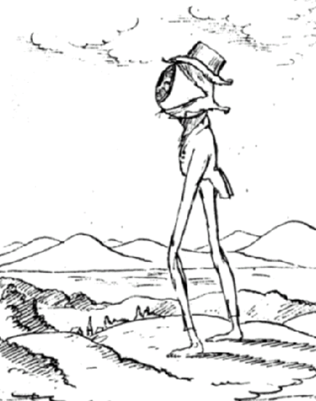
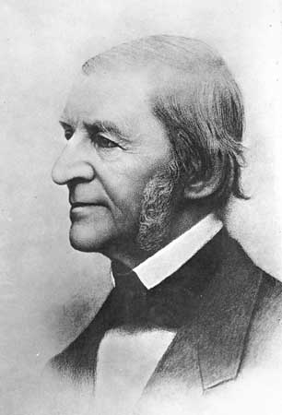
Transcendentalism (time overlap): 1840-1860
Weird
Believed in human perfectibility
Ralph Waldo Emerson’s poem “Nature.”

Slide 20
Dickinson
The main characteristic of Romanticism that Emily Dickinson portrays in her writing is the emphases of the importance of Nature to the Romantics.
In most of her poems there is some mention or comparison to something found in Nature. In Poem 449, she refers to the moss that covers the names on the graves of the tombstones of “Beauty” and “Truth.”
The Puritans believed Nature to be the realm of the devil. By including references to Nature in many of her poems, she was rebelling against the ideals of the Puritan upbringing she had hated so much.

Slide 21
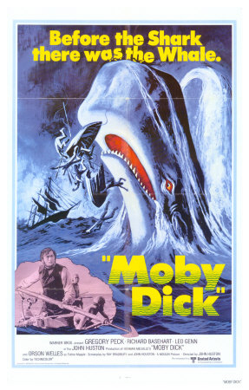
The Dark Romantics
Nathaniel Hawthorne, Edgar Allan Poe, Herman Melville
Believed what the Romantics did, but felt that at the core of everyone was a dark, sinister being
Have a lot of crazy or guilt-racked people in their stories

Slide 22
The Dark Side of Individualism
American Gothic

Slide 23
Gothic Literature
The Beginnings…
Gothic Literary tradition came to be in part from the Gothic architecture of the Middle Ages.
Gothic cathedrals with irregularly placed towers, and high stained-glass windows were intended to inspire awe and fear in religious worshipers.

Slide 24
Gargoyles—carvings of small deformed creatures squatting at the corners and crevices of Gothic cathedrals—were supposed to ward off evil spirits, but they often look more like demonic spirits themselves.
Think of the gargoyle as a mascot of Gothic, and you will get an idea of the kind of imaginative distortion of reality that Gothic represents.

Slide 25
Gothic vs. Romanticism
Romanticism developed as a reaction against the rationalism of the Age of Reason.
The romantics freed the imagination from the hold of reason, so they could follow their imagination wherever it might lead.
For some Romantics, when they looked at the individual, they saw hope (think “A Psalm of Life”).
For some Romantic writers, the imagination led to the threshold of the unknown—the shadowy region where the fantastic, the demonic and the insane reside.
When the Gothics saw the individual, they saw the potential of evil.
Romantic writers celebrated the beauties of nature.
Gothic writers were peering into the darkness at the supernatural.

Slide 26
Edgar Allan Poe
His stories have:
Settings that featuring
Dark, medieval castles
Decaying ancient estates
Characters that are
Male—insane
Female—beautiful and dead (or dying)
Plots that include
Murder
Live burials
Physical and mental torture
Retribution from beyond the grave
For Poe, it was only in these extreme situations that people revealed their true nature.

Slide 27
Gothic Movement in America
The Gothic Tradition was firmly established in Europe before American writers had made names for themselves.
By the 19th century, Edgar Allan Poe, Nathanial Hawthorne, and to a lesser extent Washington Irving and Herman Melville were using the Gothic elements in their writing.
Edgar Allan Poe was the master of the Gothic form in the United States.

